Slide 1



STUDIO SHODWE
HOME
SERVICE
ABOUT US
CONTACT US
PITCH DECK
Free Template Presentation
A presentation is a formal talk, often delivered in front of an audience, aimed at conveying information, persuading others, or sharing insights on a particular topic. Presentations can take various forms, such as verbal speeches, slideshows, demonstrations, or multimedia displays.
WWW.REALLYGREATSITE.COM

Slide 2



STUDIO SHODWE
HOME
SERVICE
ABOUT US
CONTACT US
INTRODUCTION
A presentation is a formal talk, often delivered in front of an audience, aimed at conveying information, persuading others, or sharing insights on a particular topic. Presentations can take various forms, such as verbal speeches, slideshows, demonstrations, or multimedia displays.
They are commonly used in academic, professional, and social settings to communicate ideas, proposals, reports, or findings. Effective presentations typically involve careful planning, organization, and delivery techniques to engage the audience and effectively convey the intended message.

Slide 3
STUDIO SHODWE
HOME
SERVICE
ABOUT US
CONTACT US
PROBLEM
@@PS1T$$
@@PS2T$$
@@PS1$$
@@PS2$$

Slide 4

STUDIO SHODWE
HOME
SERVICE
ABOUT US
CONTACT US
OUR SOLUTION
@@S1t$$
@@S1$$
@@S2t$$
@@S2$$

Slide 5


STUDIO SHODWE
HOME
SERVICE
ABOUT US
CONTACT US
MARKET OPPORTUNITY
@@MO1t$$
@@MO2t$$
@@MO1$$
@@MO2$$
@@MO3t$$
@@MO4t$$
@@MO3$$
@@MO4$$

Slide 6

STUDIO SHODWE
HOME
SERVICE
ABOUT US
CONTACT US
Business Model
@@B1$$

Slide 7
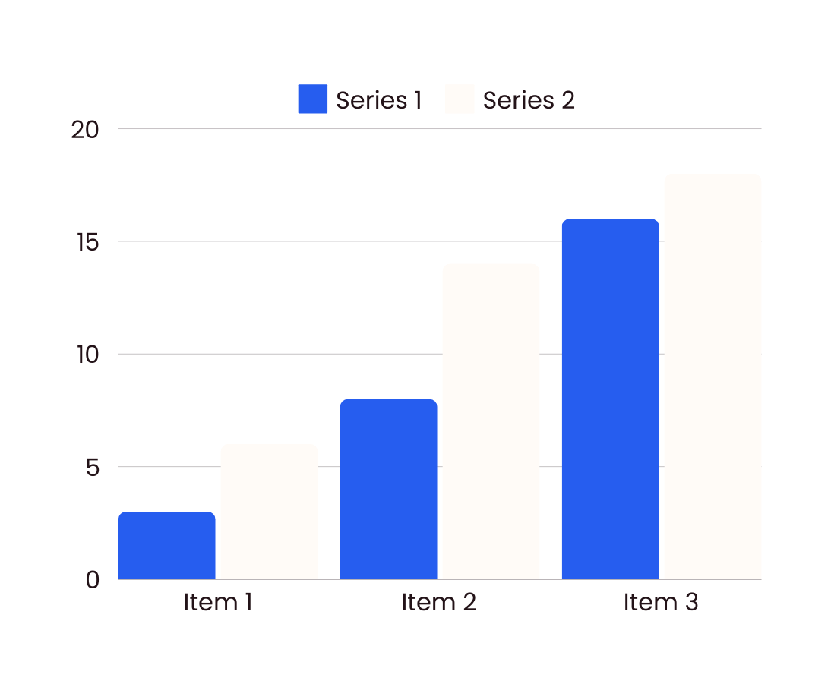
STUDIO SHODWE
HOME
SERVICE
ABOUT US
CONTACT US
FINANCIAL PROJECTIONS
A presentation is a formal talk, often delivered in front of an audience, aimed at conveying information, persuading others, or sharing insights on a particular topic. Presentations can take various forms, such as verbal speeches, slideshows, demonstrations, or multimedia displays.
Operational expenses
Marketing budgets
A presentation is a formal talk, often delivered in front of an audience, aimed at conveying information, persuading others, or sharing insights on a particular topic.
A presentation is a formal talk, often delivered in front of an audience, aimed at conveying information, persuading others, or sharing insights on a particular topic.

Slide 8




STUDIO SHODWE
HOME
SERVICE
ABOUT US
CONTACT US
OUR TEAM
Morgan Maxwell
Olivia Wilson
Neil Tran
Chiaki Sato
Job Title
Job Title
Job Title
Job Title

Slide 9







STUDIO SHODWE
HOME
SERVICE
ABOUT US
CONTACT US
CONTACT US
+123-456-7890
WWW.REALLYGREATSITE.COM
HELLO@REALLYGREATSITE.COM
123 ANYWHERE ST., ANY CITY, ST 12345

Slide 10


STUDIO SHODWE
HOME
SERVICE
ABOUT US
CONTACT US
THANK YOU
FOR YOUR ATTENTION

